Slide 1
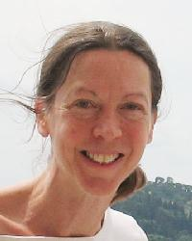
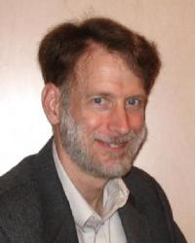
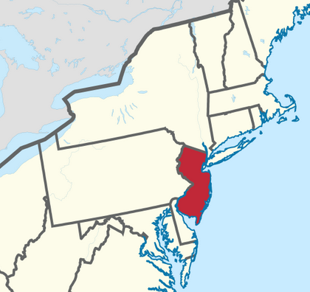
US-Africa Initiative Workshop APS March Meeting - Sunday, March 14, 2021 Sponsored by the APS Innovation Fund
Close connection with the group of
Prof. Karin Rabe
Computational design
Ferroelectrics
Antiferroelectrics
Multiferroics
Structural phase transitions
Polar conductors
Metal-insulator transitions
David Vanderbilt
Professor of Physics
Rutgers University
New Jersey, USA
http://www.physics.rutgers.edu/~dhv
Research Topics
New York
DFT calculations of
Ferroelectrics
Multiferroics
Strongly spin-orbit coupled materials
Magnetic materials
Topological insulators and semimetals
Formal theory and modeling of
Electric polarization
Orbital magnetization
Magnetoelectric coupling
Anomalous Hall conductivity
Wannier functions
Role of Berry phases and Berry curvatures
Pennsylvania
New Jersey

Slide 2
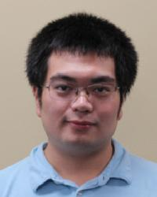
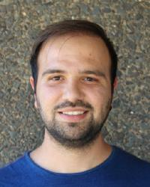
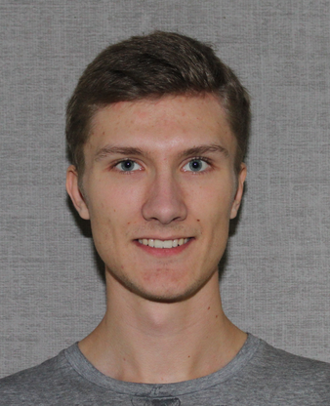
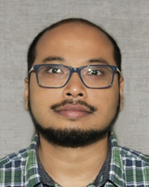
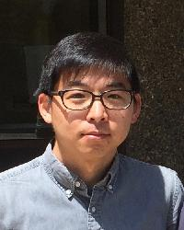
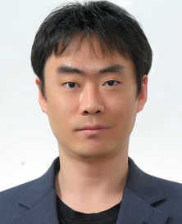
March APS presentations − Vanderbilt group
Sobhit Singh C47.00003 Prediction of phonon-mediated high-TC superconductivity …
Shang Ren M45.00004 Quadrupole moments, edge polarizations, and corner …
Santu Baidya P51.00008 NdAlSi, a type II magnetic Weyl semimetal
S. Mandal R19.00015 Beyond-DFT database of spectral function for correlated …
Jinwoong Kim S52.00012 Quantum anomalous Hall effect using interfacial Green’s …
Minsung Kim V57.00012 First-principles study on electronic structure of Cr1/3TaS2
Nico Varnava Y52.00010 Controlling a quantum point junction on the surface of an …
Daniel Seleznev Y52.00013 Towards a theory of surface orbital magnetization
Students Postdocs

