Slide 1
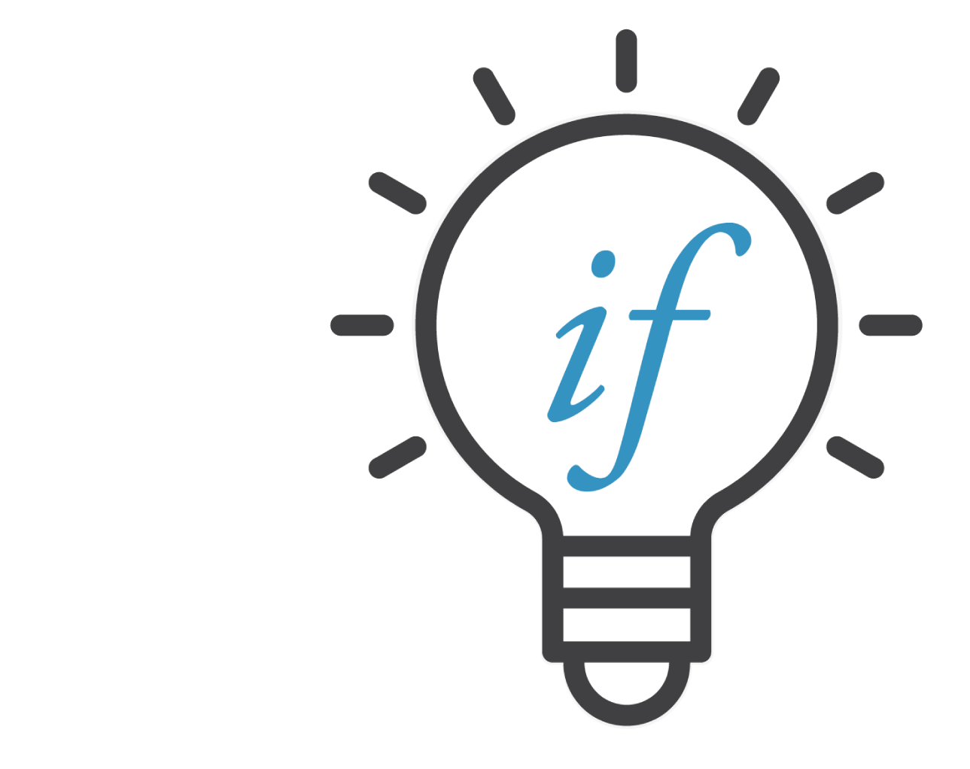
US-Africa Initiative Workshop APS March Meeting - Sunday, March 14, 2021 Sponsored by the APS Innovation Fund
My story of US-Africa collaboration (I think it is worth sharing here): In the summer of 2016, I attended a workshop at Sherbrooke University, Canada. There I met Cecil Ouma from Pretoria, RSA. Our physics discussions over beer and food during our stay in Canada led to an interesting collaboration between two students and three countries: South Africa, Kenya, and US. Our work was later published in PCCP.
Cecil N. M. Ouma, Sobhit Singh, K. O. Obodo, G. O. Amolo, and Aldo H. Romero, Phys. Chem. Chem. Phys. 19, 25555-25563 (2017).
Sobhit Singh
Postdoctoral Associate
Department of Physics & Astronomy
Rutgers University, New Jersey, USA
sobhit.singh@rutgers.edu
https://sites.google.com/view/sobhit-singh/
Research Interests:
Topological materials
Ferroelectrics/Antiferroelectrics
Novel magnetism
Superconductivity
Materials having strong spin-orbit interactions
Structural search & studying phase transitions
Polar metals/conductors
Berry-curvature induced phenomena
- I am a postdoc at Rutgers working jointly with Prof. David Vanderbilt and Prof. Karin Rabe.
- My research focuses on the development and application of computational methods to discover and design novel quantum materials (bulk and 2D) with interesting properties.
- I am particularly interested in materials consisting of one or more of the following features:
Software development:
MechElastic
PyProcar

Slide 2
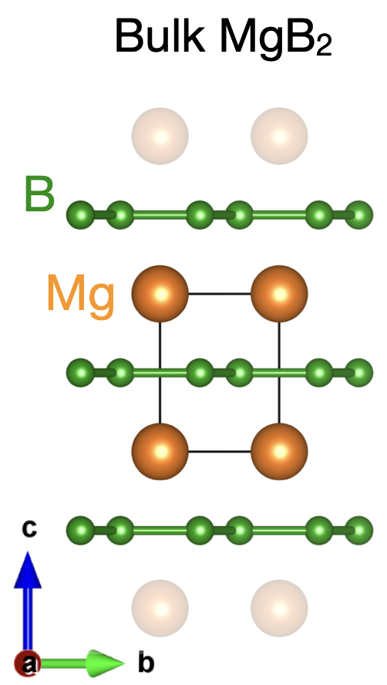
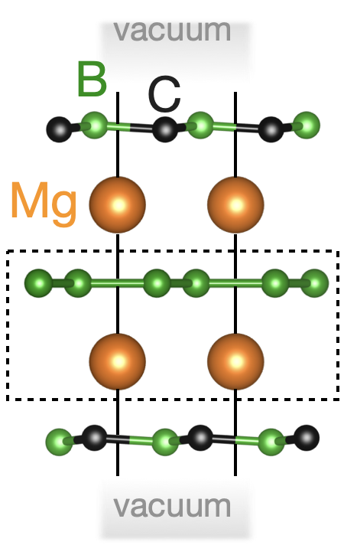
Ab-initio design of high-T_{C} 2D superconductor: Mg₂B₄C₂ monolayer
APS March Meeting Talk: Prediction of phonon-mediated high-T_{C} superconductivity in monolayer Mg₂B₄C₂
C47.00003: Session C47; 3:00 PM–5:48 PM, Monday, March 15, 2021
Intrinsic T_{C} in 2D superconductors (phonon-mediated): Max. 10-20 K range!
T_{C} = 40 K
DOS(E_{F}) = 9.8 states/spin/Ry
λ_{el-ph} = 0.6-0.7
Mainly from two E_{2g} phonons (97% coupling)
(in-plane B-B stretching)
Monolayer Mg₂B₄C₂
Stable monolayer
Chemically inert surfaces
T_{C} = 47-48 K
DOS(E_{F}) = 13 states/spin/Ry
λ_{el-ph} = 1.40
More than just two phonons contribute to T_{C}
Topologically nontrivial
Issues:
Highly reactive surface
Bandgap opening in 2D limit
Only two modes contribute to superconductivity

