Slide 1
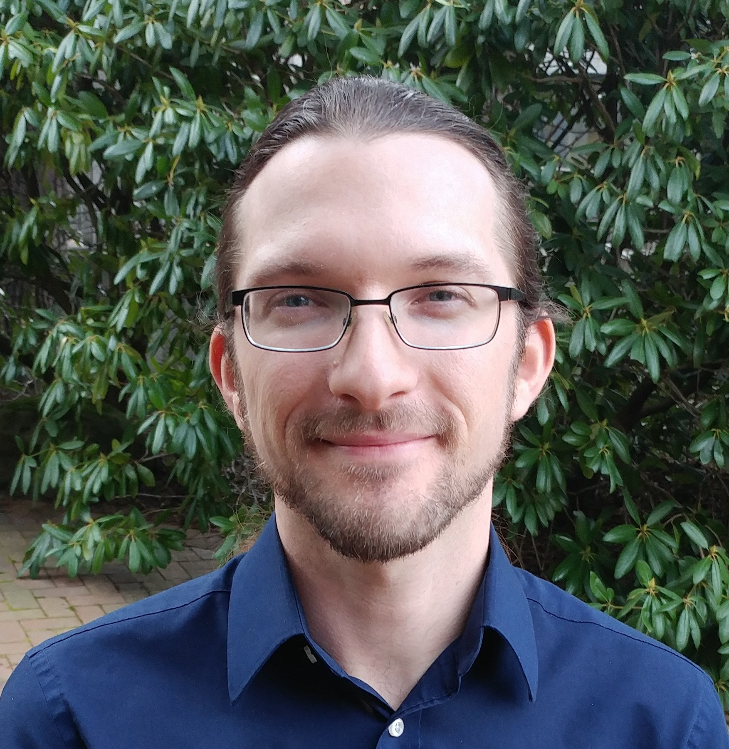
Our team…
is typically between six and twelve members;
skews toward early-career researchers: most members are undergraduates or MS students
collaborates with scientists at home and internationally, currently including the UK, Thailand, Germany, Japan, and Singapore
US-Africa Initiative Workshop APS March Meeting - Sunday, March 14, 2021 Sponsored by the APS Innovation Fund
Tim Kowalczyk
Associate Professor he/him
Department of Chemistry
Advanced Materials Science and Engineering Center (AMSEC)
Institute for Energy Studies
Western Washington University
Time-independent excited state electronic structure methods; Applications to photoactive organic materials
Our collaborative opportunities...
We develop primarily within DFTB+, which unites a globally dispersed community of electronic structure theorists interested in density-functional tight-binding methods
We would love to discuss with any folks who have a use case for fast, approx. excited-state electronic energies, gradients, and properties!
Charge mobility in covalent organic frameworks
Energy conversion, storage in solar thermal fuels

