Slide 1
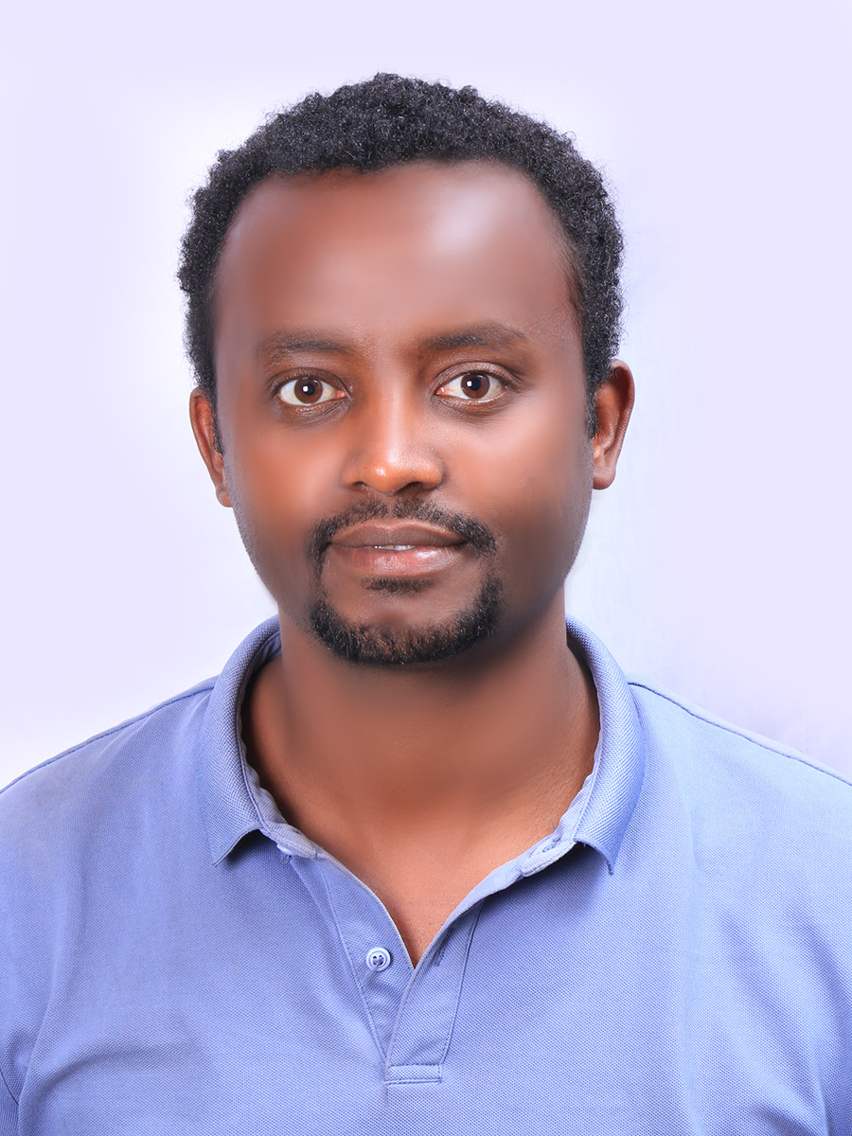
US-Africa Initiative Workshop APS March Meeting - Sunday, March 14, 2021 Sponsored by the APS Innovation Fund
Gamachis Sakata Gurmesa
PhD candidate
Addis Ababa University (AAU), Ethiopia
gamachis.sakata@aau.edu.et
I am a PhD student in the group of
Dr. Yedilfana Setarge Mekonnen (https://scholar.google.com/citations?user=H8Q6rdsAAAAJ&hl=en ) who focuses mainly on computational study of rechargeable batteries,
Dr. Girum Ayalneh Tiruye (https://scholar.google.com/citations?user=yrxpONIAAAAJ&hl=en ) who focuses mainly on experimental investigation of Supercapacitors,
Dr. Chernet Amente Geffe (https://www.researchgate.net/profile/Chernet-Amente ) who mainly focuses on Spintronics and
Prof. Qinfang Zhang (https://scholar.google.com/citations?user=t9n8nEAAAAAJ&hl=en ) who mainly focuses on catalysis and spintronics.
“Computational Investigation of Efficient and Affordable Energy Conversion and Storage Materials”
These include: Rechargeable Lithium-ion batteries, PEM fuel cells, photocatalysis and solar cells. Moreover, we also interested in studying applications: flexible devices, spintronics, electro-optics applications.
We primarily, using computational tools such as density functional theory (DFT), molecular dynamics (MD) and Machine learning (ML) approaches. We are trying to establish experimental lab and but also collaborate with others.

Slide 2
Moreover, we have some collaborators:
Dr. Tamiru Teshome (Topological Insulators, Energy Storage Materials),
Dr. Natei Ermias Benti (Metal-Air Batteries),
Dr. Gashaw Beyene Kassahun (Photocatalysis),
Mr. Mesfin Diro a PhD student (Machine Learning for Energy Materials),
Mr. Genene Shiferaw a PhD student (2D Materials),
Mr. Firew Gashaw a MSc. student (2D materials) and
Mr. Misgana Tsegaye a MSc. student (Photocatalysis).

Slide 3
Some international collaborating institutions
Brookhaven National Laboratory with Center for Functional Nanomaterials (NY-USA)
Technical University of Denmark (DTU),
Yancheng Institute of Technology and Fudan University of China
Indian Association for the Cultivation of Science
Abdu Salam International Center for Theoretical Physics (ICTP-Trieste-Italy)
Challenge: we have limited computational resource, and we need support in this regards.

Slide 4
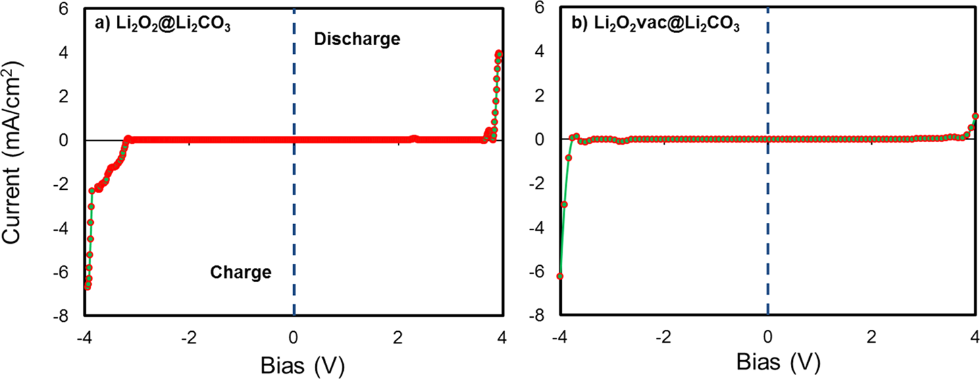
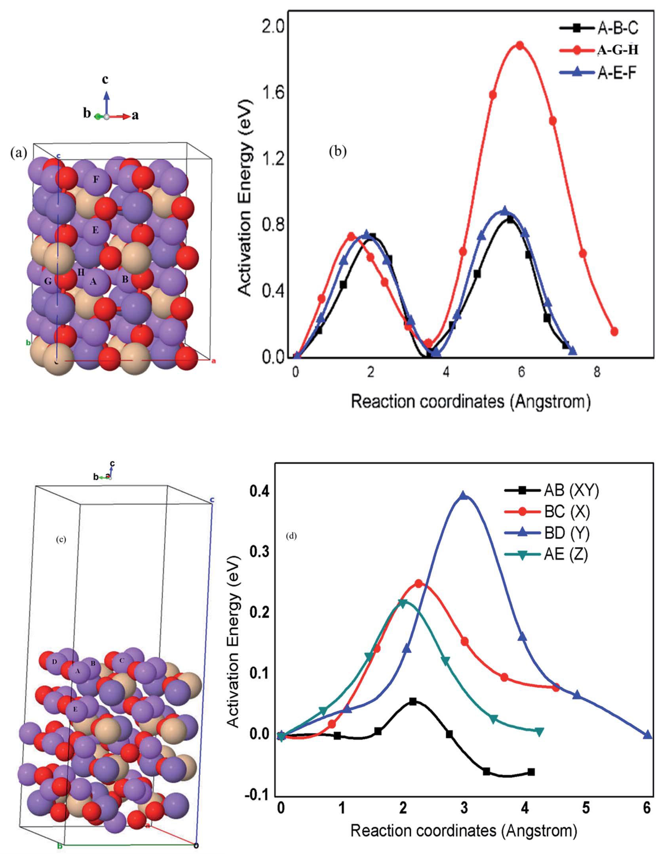
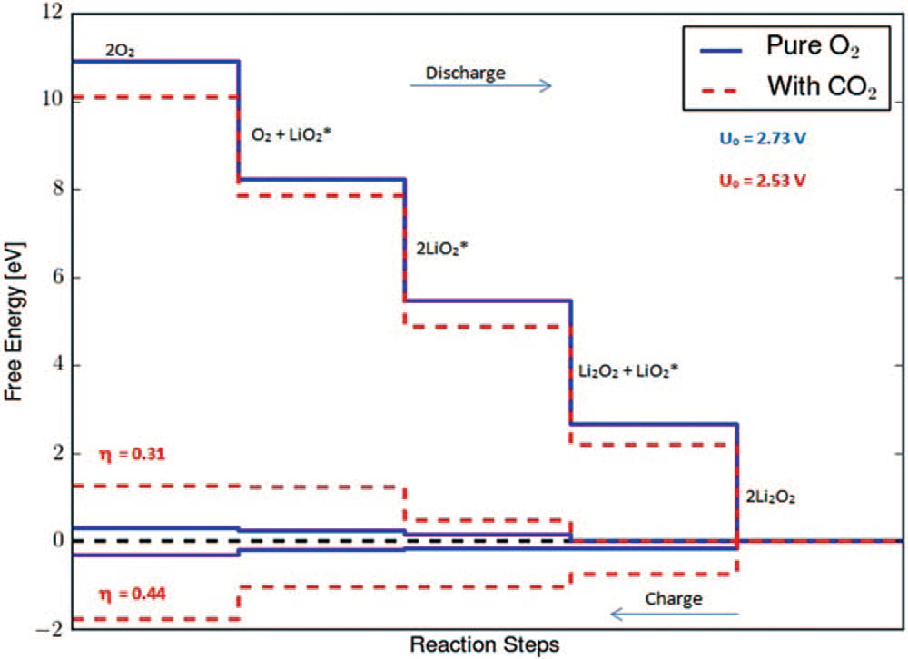
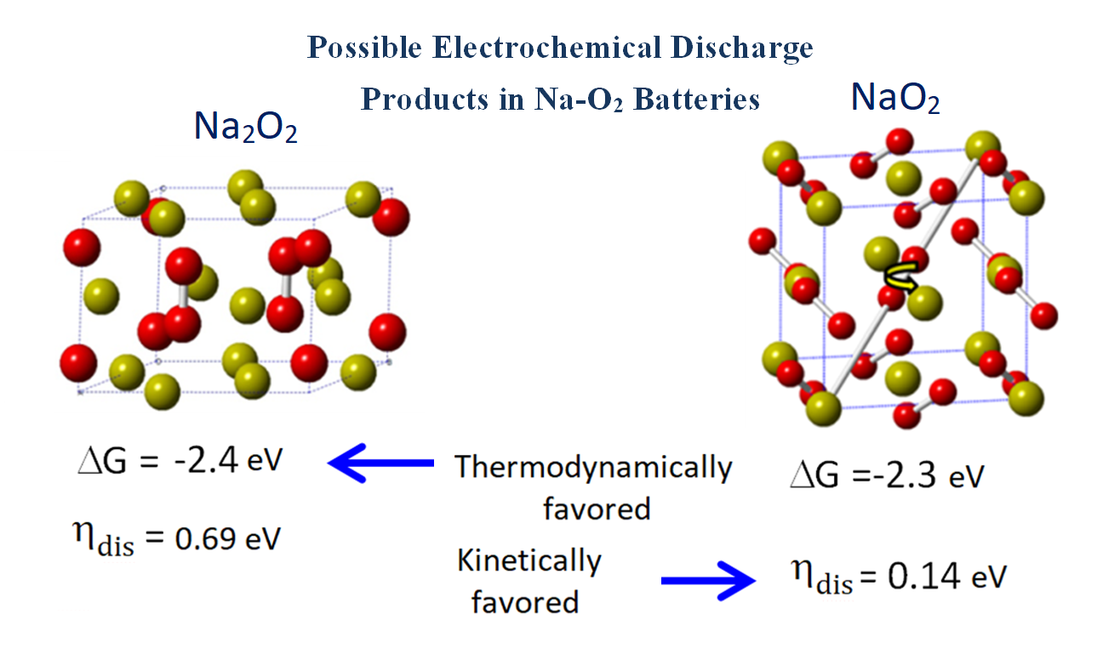
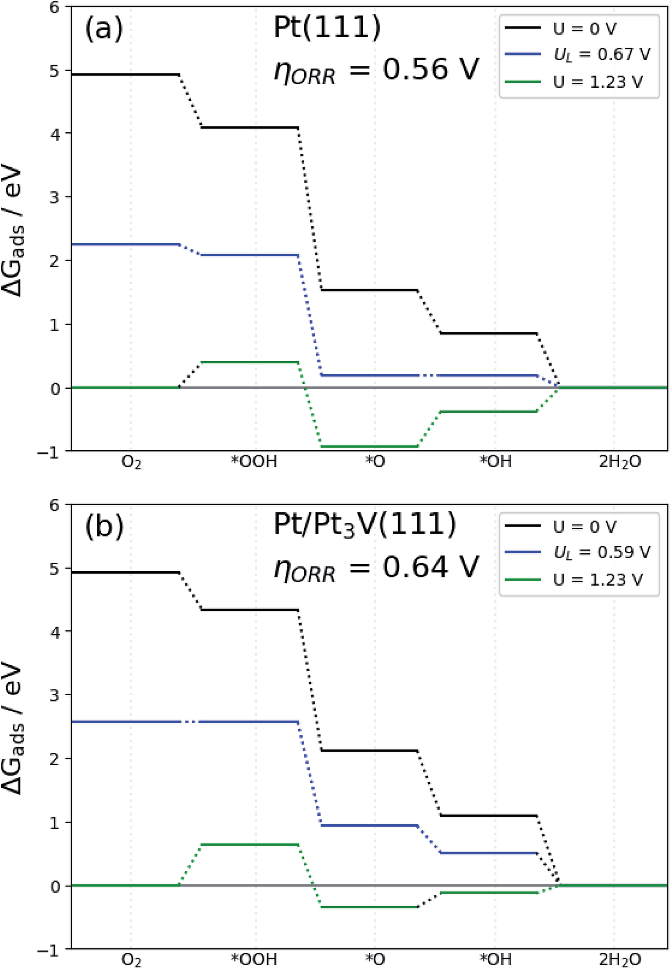
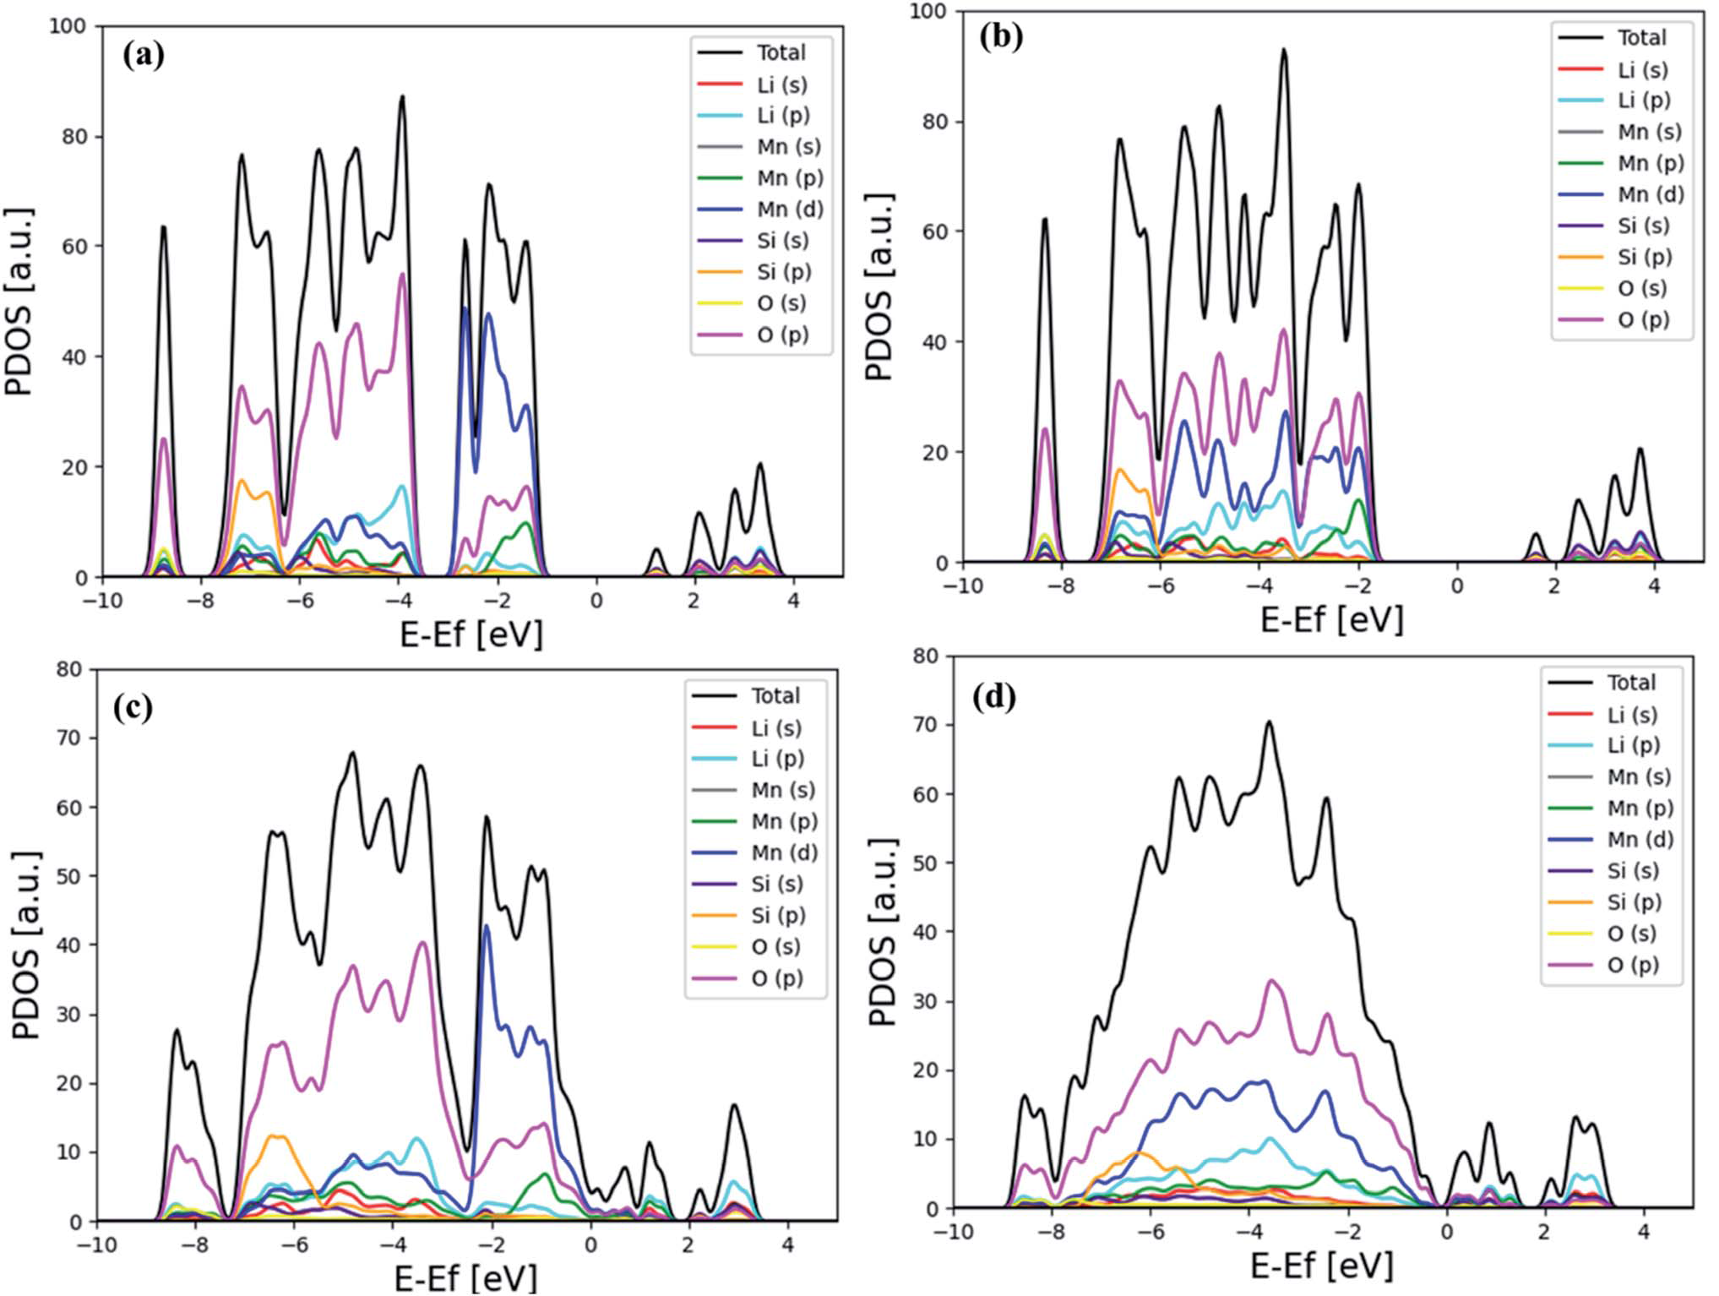
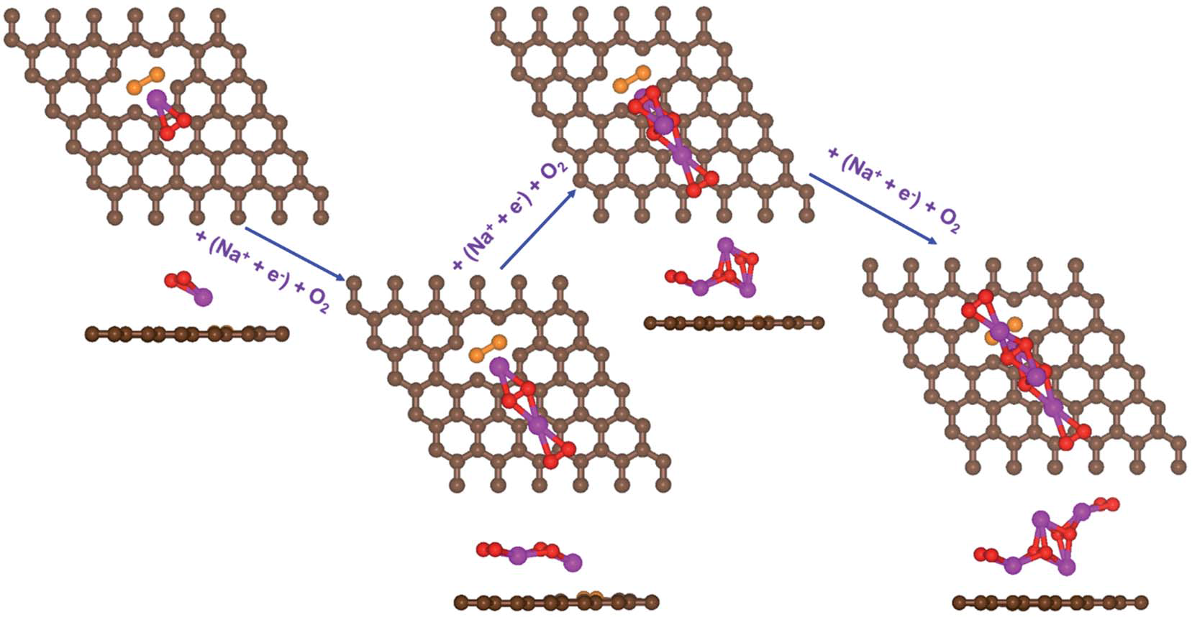
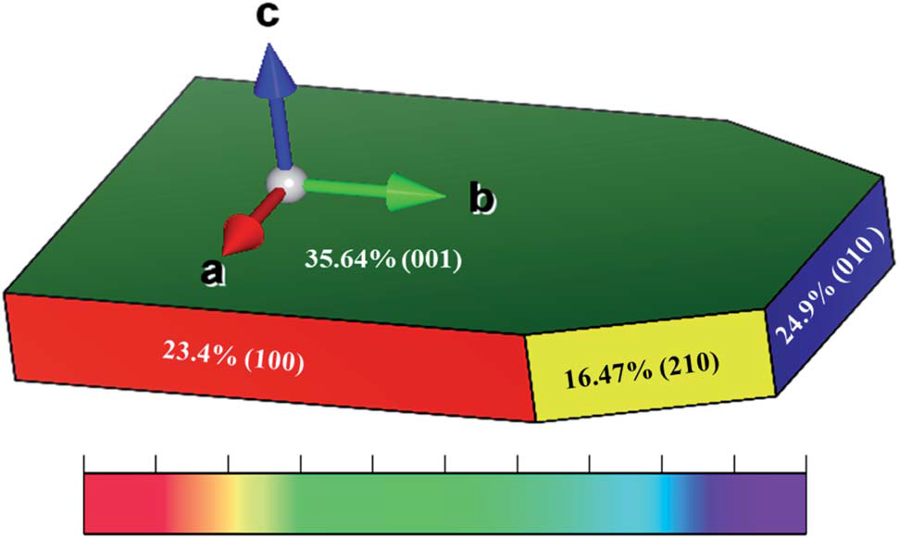
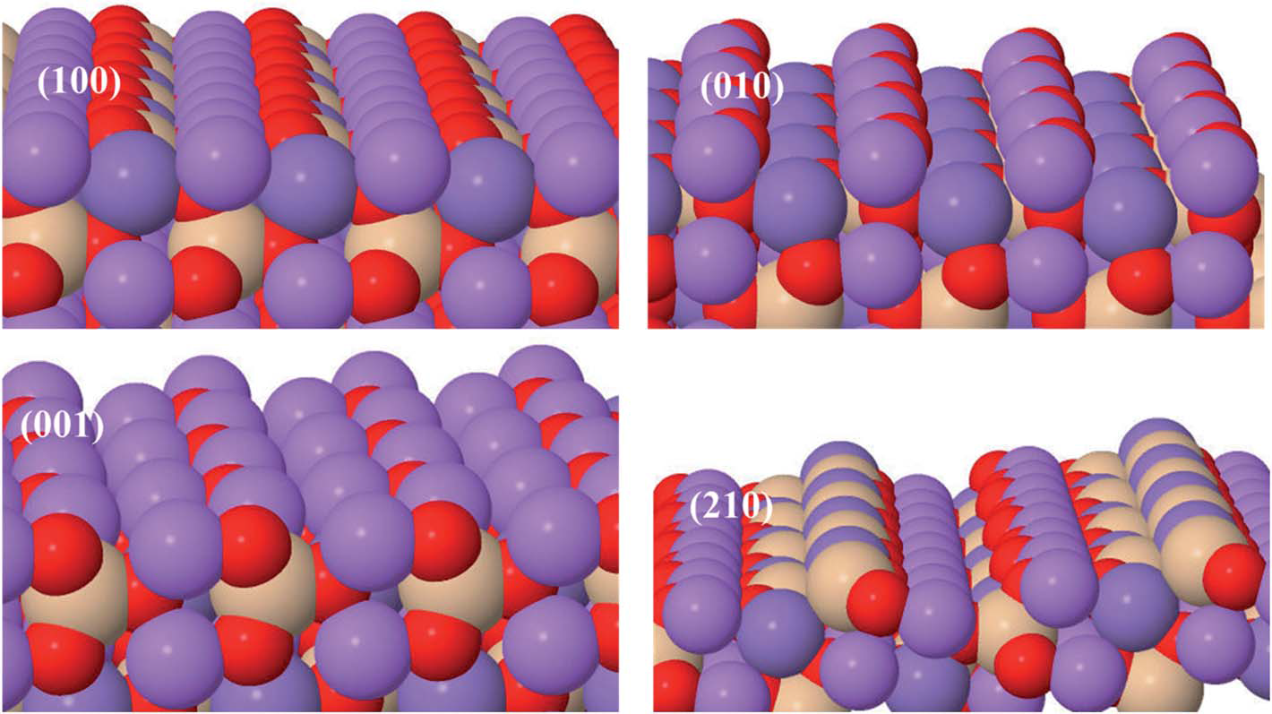
Some results from the group work:
DOI: 10.1063/1.5141931. J. Chem. Phys.
DOI: 10.1021/acs.jpcc.5b04432. JPCC
DOI: 10.1021/acs.jpclett.8b01790
DOI: 10.1039/D0RA02972F, RSC Adv.
DOI: 10.1039/d1ra00642h,
RSC Adv., 2021, 11, 9721.
DOI: 10.1039/d0ra03126g. RSC Adv.

Slide 5
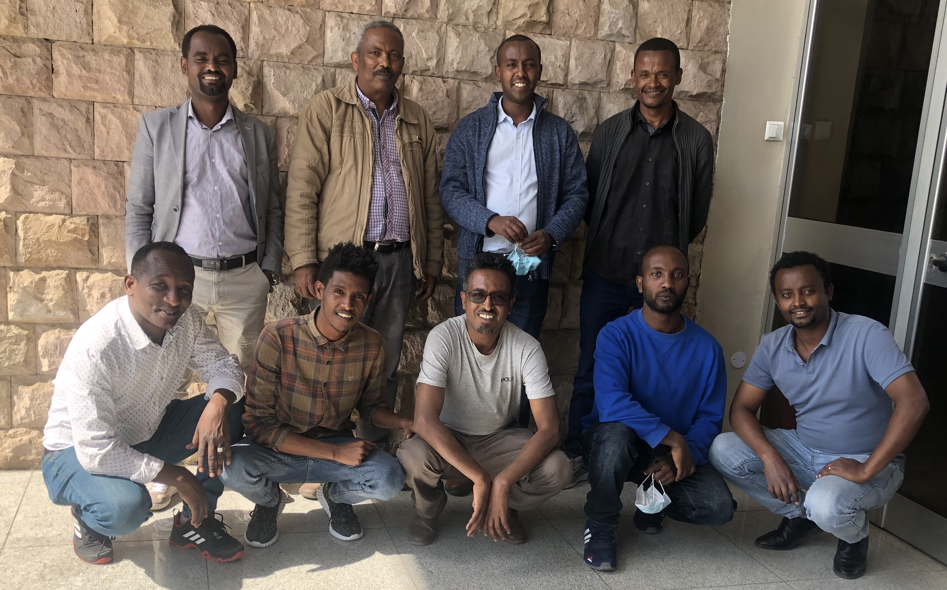
Photo @AAU with some group members
From left to right:
Standing:
Dr. Girum,
Dr. Chernet,
Dr. Yedilfana,
Mr. Negash
Sitting:
Mr. Getachew,
Mr. Firew,
Mr. Mesfin,
Mr. Gamachis

Slide 6
Selected Publications from the research Group working on Materials computational modeling
Haile, Asnake; Hansen, Heine; Yohannes, Weldegebriel; Mekonnen, Yedilfana, Pyridinic Type N-doped Graphene on Cobalt Substrate as Efficient Electrocatalyst for ORR in Acidic Solution in Fuel Cell”. The J. of Physical Chemistry Letters (revision).
Gamachis S Gurmesa, Natei E Benti, Mesfin D Chaka, Girum A Tiruye, Qinfang Zhang, Yedilfana S Mekonnen, Chernet A Geffe, Fast 3D-lithium-ion diffusion and high electronic conductivity of Li₂MnSiO₄ surfaces for rechargeable lithium-ion batteries, RSC Advances, 2021, 11, 9721, DOI: 10.1039/d1ra00642h..
Asnake S Haile, Weldegebriel Yohannis and Yedilfana S Mekonnen “Oxygen Reduction Reaction on Pt-skin Pt3V(111) Fuel Cell Cathode: A density functional theory study” RSC Advances, 10(46), 27346–27356, 2020. DOI: 10.1039/d0ra02972f.
Natei E Benti, Girum A Tiruye, Yedilfana S Mekonnen Boron and pyridinic nitrogen-doped graphene as potential catalysts for rechargeable non-aqueous sodium–air batteries. RSC Advances, 2020, 10, 21387-21398 DOI: 10.1039/D0RA03126G.
Natei E Benti, Yedilfana S Mekonnen, Rune Christensen, Girum A Tiruye, Juan María García- Lastr and Tejs Vegge. The effect of CO2 Contamination in Rechargeable Non-aqeous Sodium- Air batteries, Journal of Chemical Physics, 152(8), 74711, (2020). https://doi.org/10.1063/1.5141931.
Yedilfana S Mekonnen, Rune Christensen, Juan María García-Lastr and Tejs Vegge (2018). Thermodynamic and Kinetic Limitations for Peroxide and Superoxide Formation in Na–O2 Batteries, The Journal of Physical Chemistry Letters, 2018, 9(15), 4413-4419. https://pubs.acs.org/doi/10.1021/acs.jpclett.8b01790.
Yedilfana S Mekonnen, Juan María García-Lastr, Jens S. Hummelshøj, Chengjun Jin and Tejs Vegge (2015). Role of Li2O2@Li2CO3 Interfaces on Charge Transport in Nonaqueous Li−Air Batteries, Journal of Physical Chemistry C, 2015, 119, 32, 18066-18073. doi.org/10.1021/acs.jpcc.5b04432.
Yedilfana S Mekonnen, Kristian B. Knudsen, Jon S. G. Myrdal, Reza Younesi, Jonathan Hojberg, Johan Hjelm, Poul Norby and Tejs Vegge (2014). Communication: The influence of CO2 poisoning on overvoltages and discharge capacity in non-aqueous Li-Air batteries. J. Chem. Phys. 140, 121101 (2014) + Journal Cover Page.
Tamiru Teshome, Gamachis S. Gurmesa, Ayan Datta, Girum A. Tiruye, Yedilfana S. Mekonnen, Chernet Amente. Graphene-Borophene interface for promoted negative electrode in Rechargeable Lithium–Ion and Sodium-Ion Batteries. Manuscript in preparation.

