Slide 1



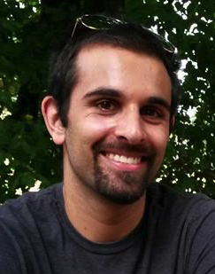
US-Africa Initiative Workshop
APS March Meeting - Sunday, March 14, 2021
Sponsored by the APS Innovation Fund
Many-body quantum calculations and effective low-energy physics
University of Illinois at Urbana-Champaign
Lucas K. Wagner
Assistant Professor
lkwagner@illinois.edu
High accuracy calculation of electronic systems using quantum Monte Carlo and other techniques
Yueqing Chang
Graduate student
Effective Hamiltonians from high-accuracy solutions
William Wheeler
Graduate student
Code development and dissemination
Notes:
[In the rest of the space on this slide, please provide:
- Description of your primary interests and research goals, work that you have accomplished so far....continued in next column
Information on the group in which you work (names of other people directly related to your work, how many people total, types of work in the group, topical areas)
- What collaborations have been helpful so far, if any.
- What collaborations or resources would be beneficial in the next steps?
- Any links to more information or samples]

Slide 2
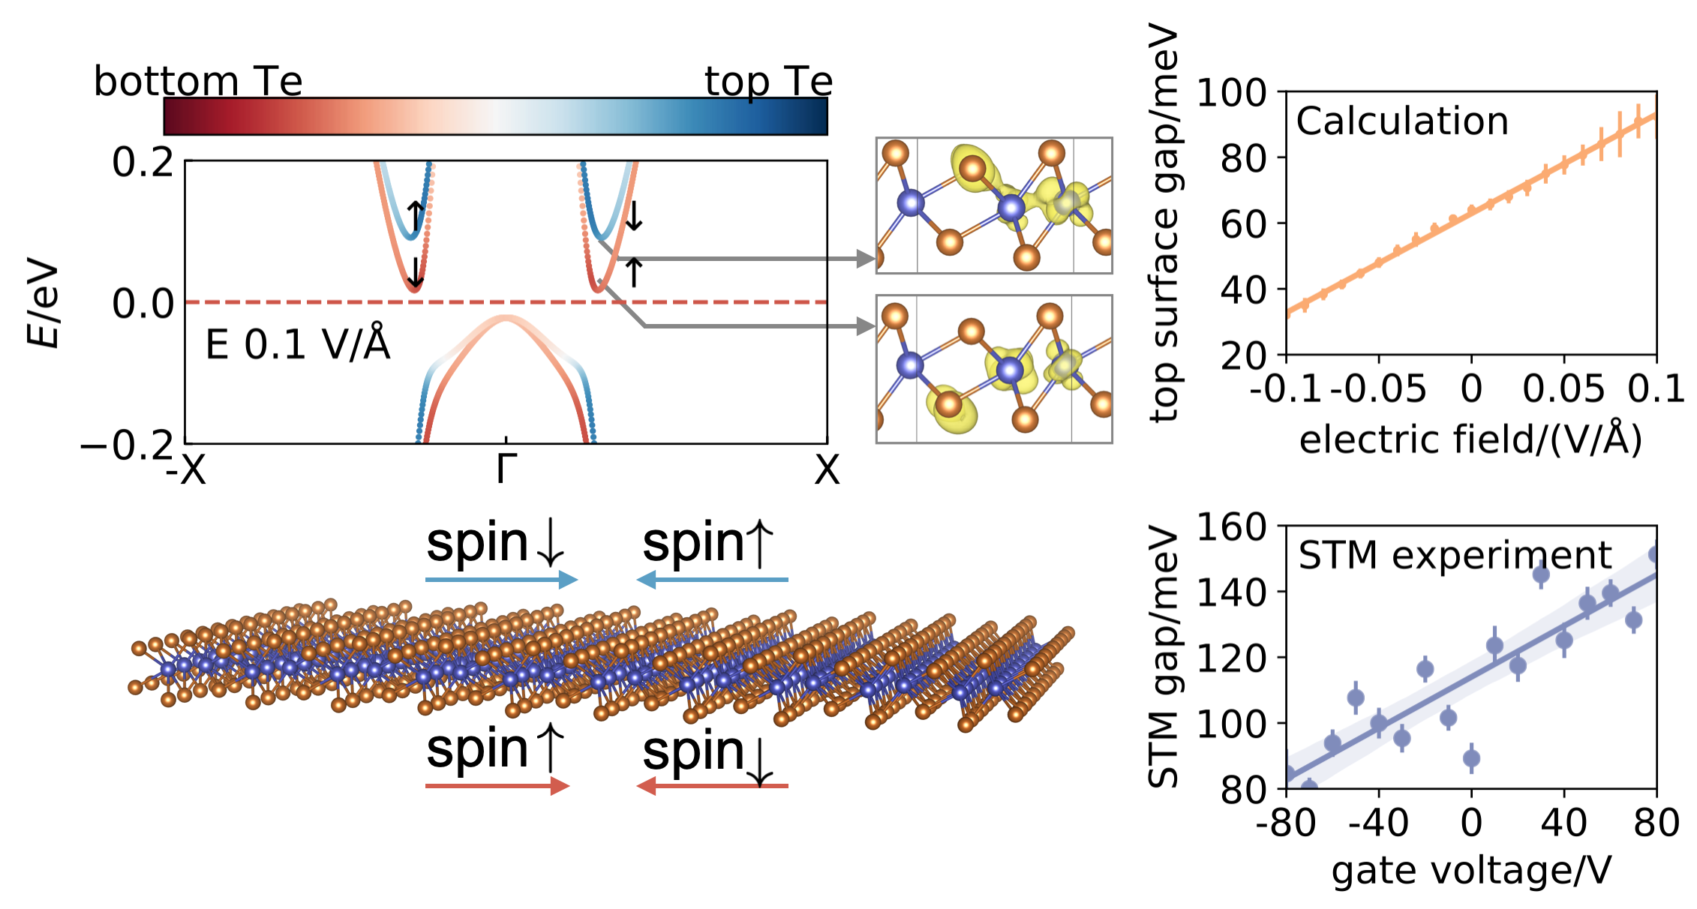
Layer-dependent spin-momentum locking in monolayer 1T’-WTe2
arXiv 2011.10096
R45.00010
Yulia Maximenko, Yueqing Chang, Guannan Chen, Mark R. Hirsbrunner, Waclaw Swiech, Taylor L. Hughes, Lucas K. Wagner and Vidya Madhavan
PyQMC: all-Python, real-space
Quantum Monte Carlo code
github.com/wagnergroup/pyqmc
E19.00009
William A. Wheeler, Shivesh Pathak, Joao N.B. Rodrigues, Cooper Lorsung, Yueqing Chang, Yiqing Zhou, Brian Busemeyer, Kiel T. Williams, Alexander Munoz, and Lucas K. Wagner
Also see:
F22.00011 Excited states in variational Monte Carlo using a penalty method
R45.00001 Tuning the band structure of monolayer WTe2 using back-gating in STM

