Slide 1
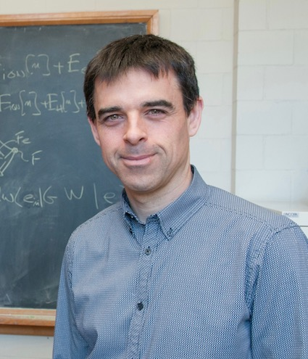
US-Africa Initiative Workshop APS March Meeting - Sunday, March 14, 2021 Sponsored by the APS Innovation Fund
We use electronic structure methods to study « interesting materials ».
Some subjects of study:
- Electron-phonon coupling:
- Renormalization of electronic states
- Superconductivity
- Unconventional superconductor: Sr₂RuO₄
- Machine learning for Raman spectrum
- Energy materials: electrolytes
March Meeting talks by members of the group:
B21.7 Machine Learning
C48.2 Superconductivity in Sr₂RuO₄
E20.4 El-ph and SOC in ZPR
J20.03 Resistivity calculation in Sr₂RuO₄
Michel Côté
Université de Montréal
Montréal, Québec, Canada
Email: Michel.Cote@umontreal.ca
Electron-phonon coupling, superconductivity, battery and machine learning
Particularities: Montréal is located in the French-speaking province of Québec, in Canada. It is a cosmopolitan city where people speak French and English. Our group conducts research in both languages.
We are users and developers of the ABINIT package.

