Slide 1
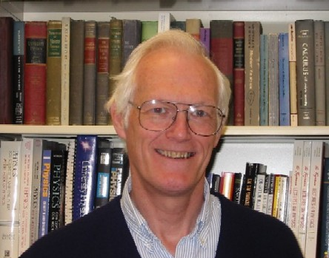
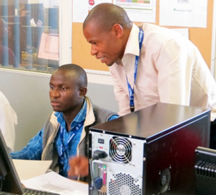
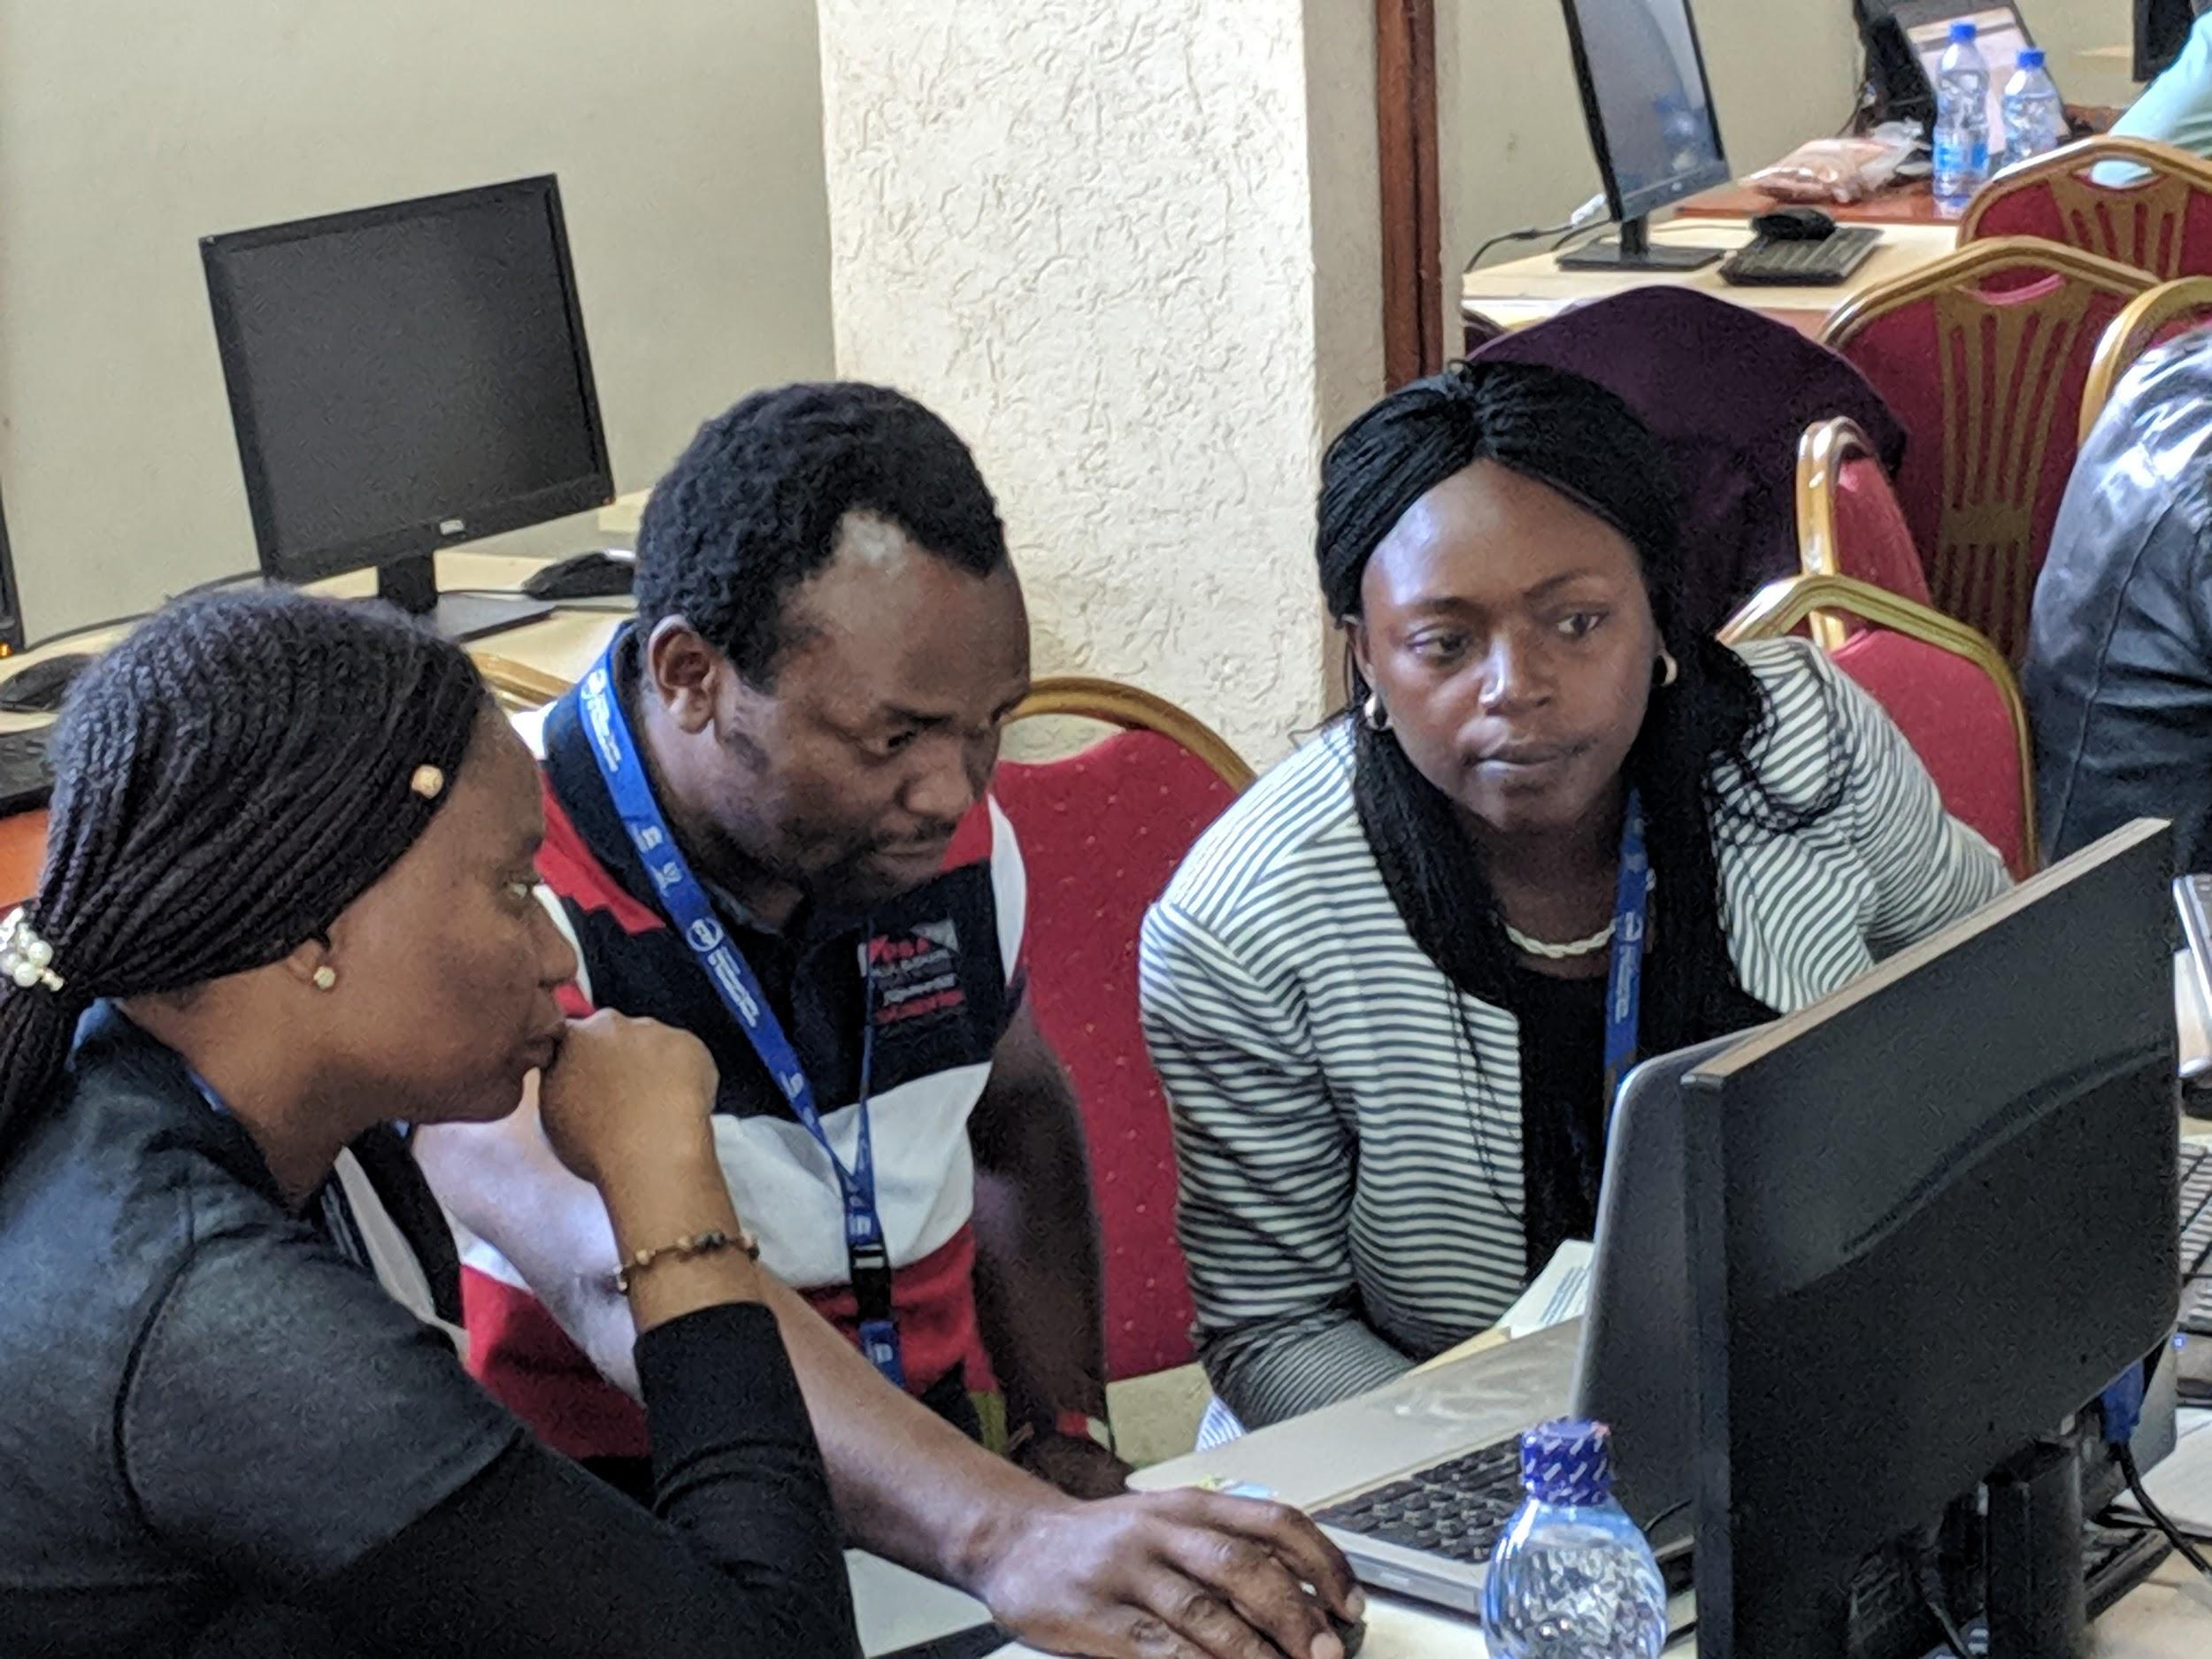
One of the most successful innovations of ASESMA was
Tutors and Mentors
Young people (advanced students, postdocs, young faculty)
In an ASESMA school tutors and mentors could relate to the students and explain MUCH better than anything one can get from a lecture!
US-Africa Initiative Workshop APS March Meeting - Sunday, March 14, 2021 Sponsored by the APS Innovation Fund
Richard M. Martin
University of Illinois
Stanford University
Tutors, Mentors, Peers
One of the best innovations of ASESMA was Tutors and Mentors
Young people (advanced students, postdocs, young faculty)
In an ASESMA school, tutors and mentors relate to the students and explain
MUCH better than anything one can get from a lecture!
USAfrI is meant to foster collaborations – not a school
In a collaboration and group activities, peers relate to one another and explain to one another.
Effective, stimulating, enlightening, rewarding!
I can say from observation over many years that tutors and mentors make a huge difference and they find it very rewarding. I believe the same benefits and rewards can happen with peers!
Before 2020
After 2020
Now there are
many more
opportunities!
Become a Peer!
Register at
usafricainitiative.org
ASESMA and USAfrI
are people working togther!

