Slide 1
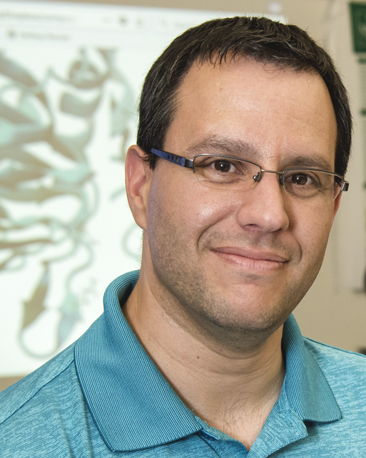
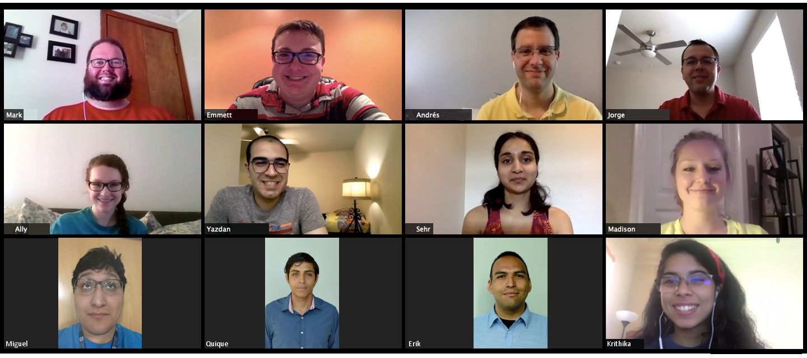
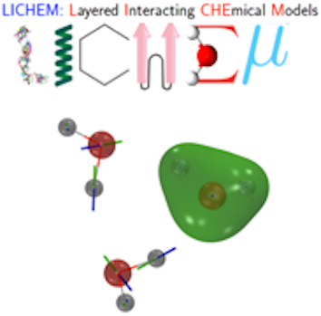
US-Africa Initiative Workshop APS March Meeting - Sunday, March 14, 2021 Sponsored by the APS Innovation Fund
@CisnerosRes
https://github.com/CisnerosResearch
Prof. G. Andrés Cisneros
Department of Chemistry
University of North Texas
andres@unt.edu
http://chemistry.unt.edu/~CisnerosResearch
Development and application of QM, hybrid QM/MM, and classical MD approaches for molecular simulations in the condensed phase
- We are the main developers of LICHEM and contribute to Psi4, Amber and Tinker Software
- We collaborate with other theorists to develop methods for QM and QM/MM simulations
- We collaborate with experimental groups to investigate cancer mutations, properties of ionic liquids, etc

