Slide 1
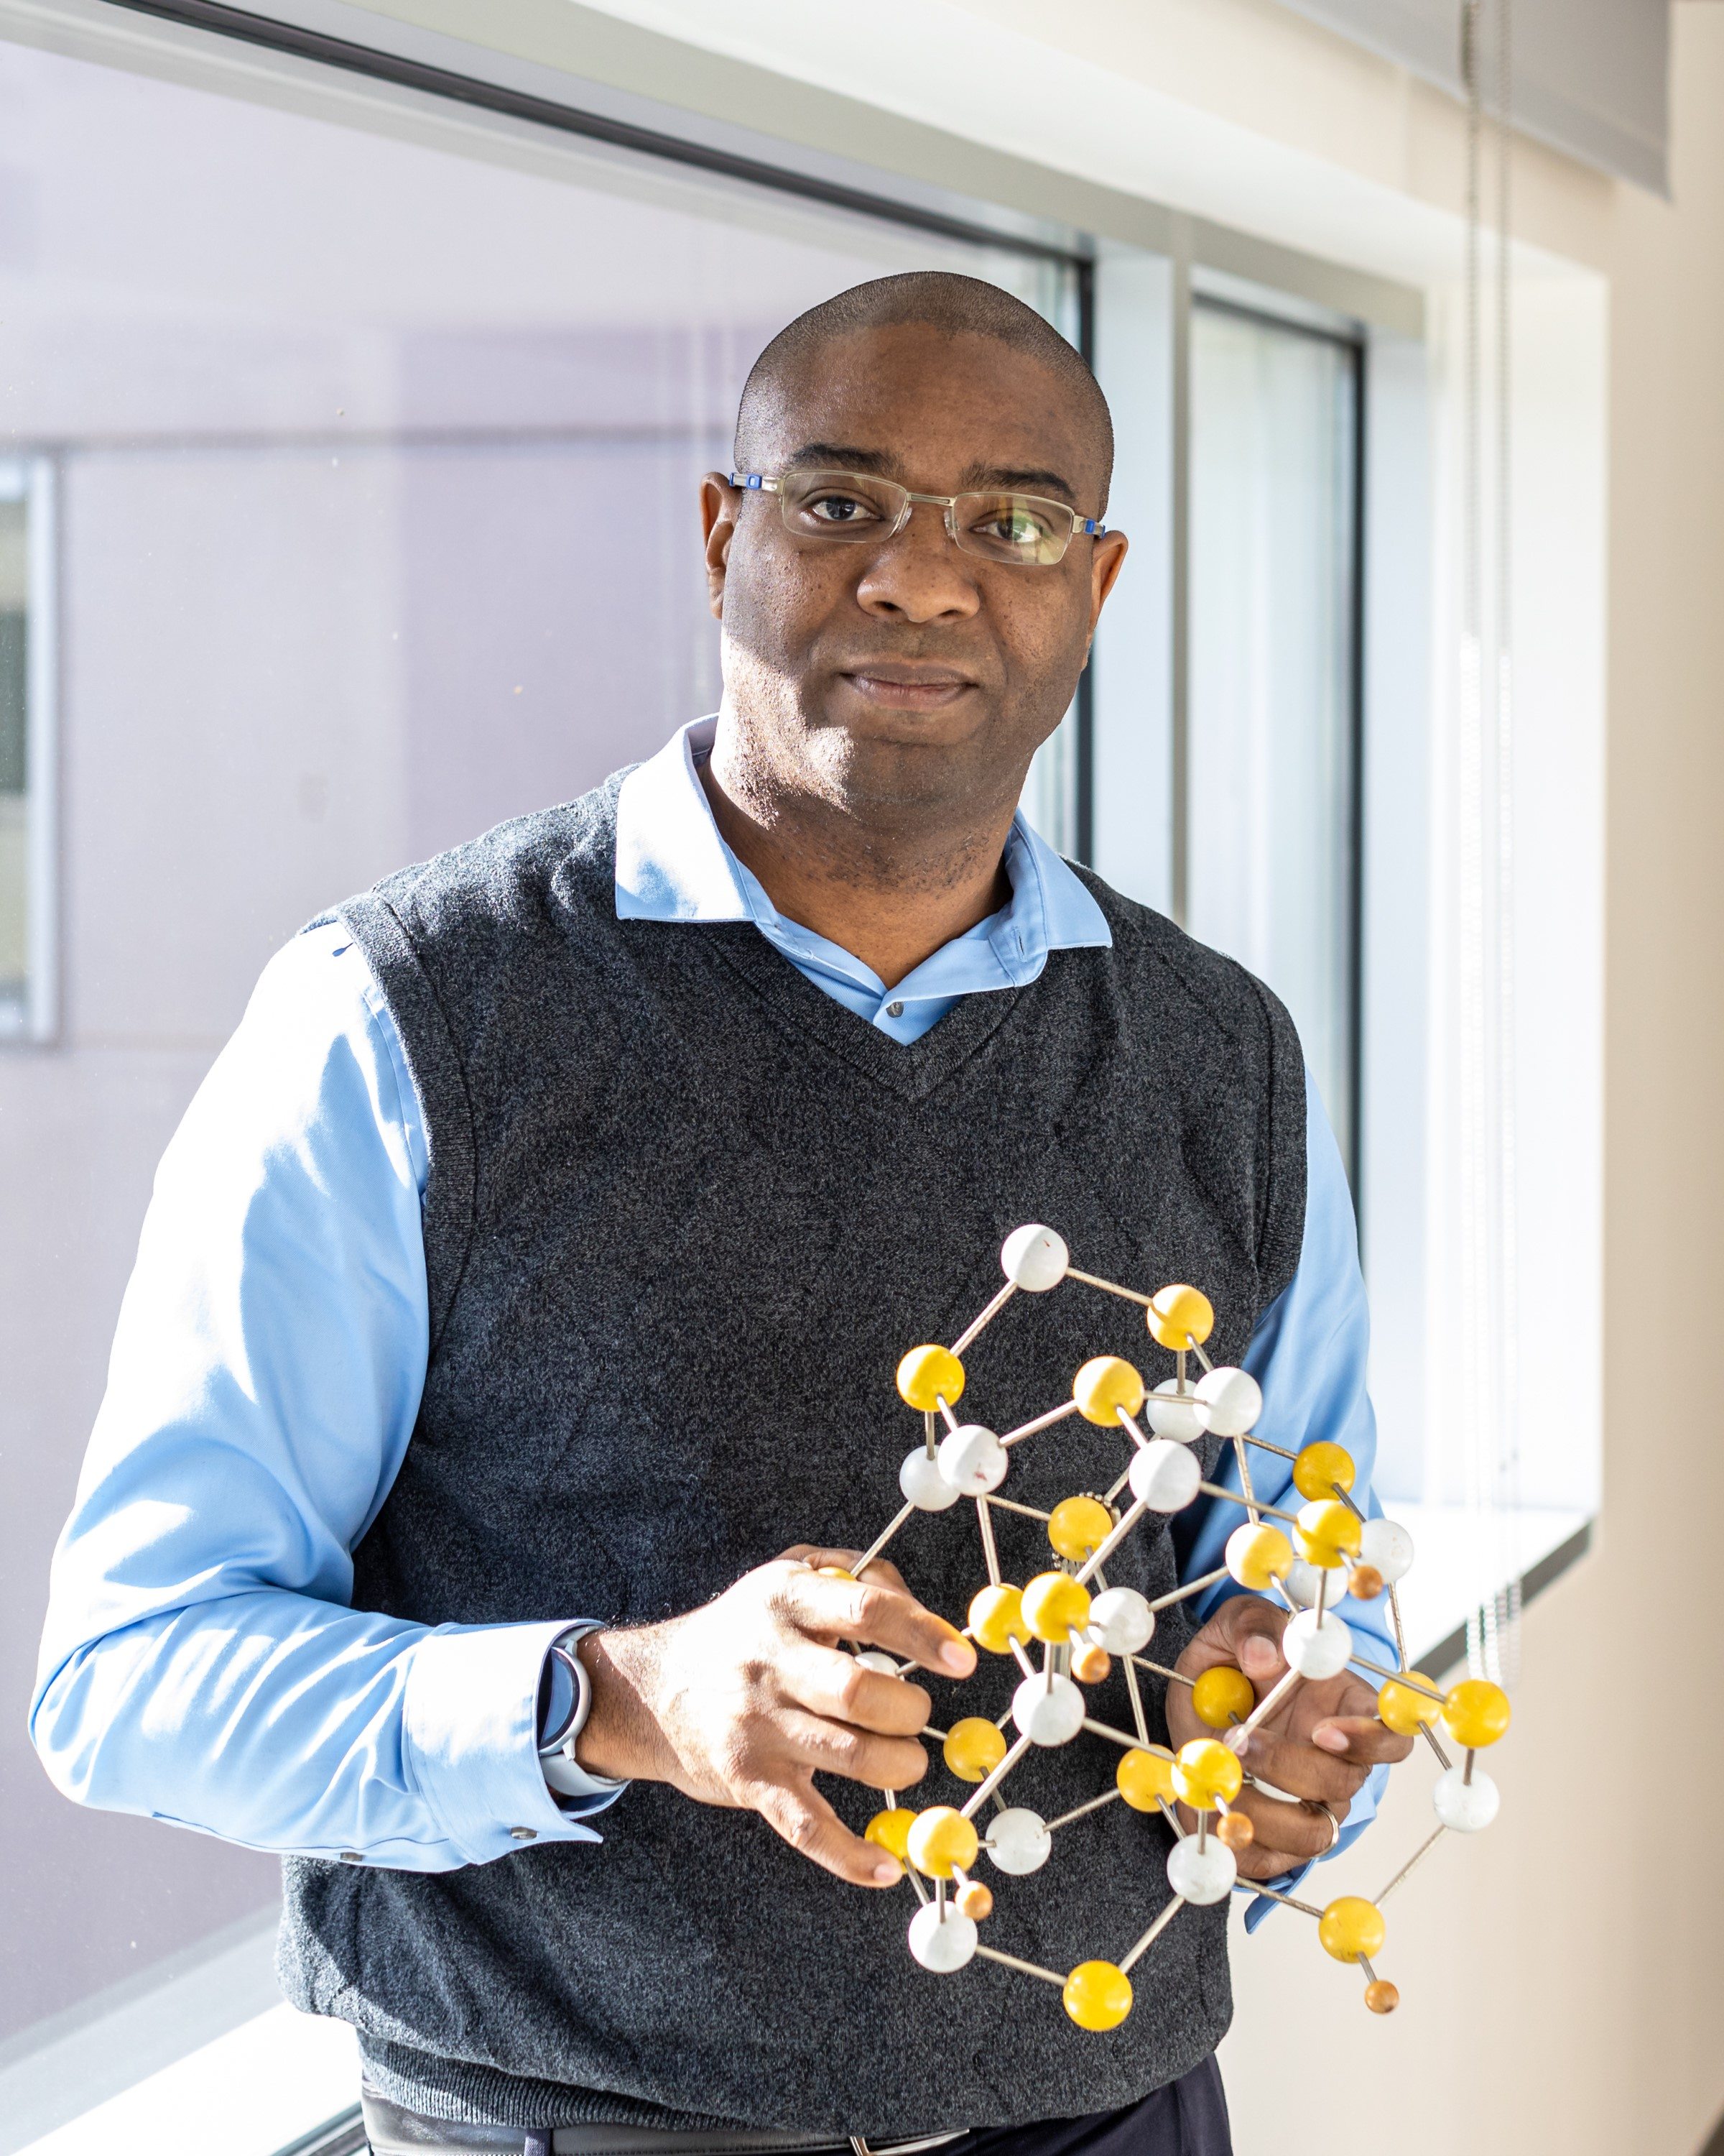
US-Africa Initiative Workshop APS March Meeting - Sunday, March 14, 2021 Sponsored by the APS Innovation Fund
Our group employs first-principles DFT methods along with phenomenological models and stochastic sampling techniques to examine design and discover complex materials…
We are a highly collaborative group, working with:
other theorists in the fields of quantum Monte Carlo, stochastic sampling approaches and machine learning,
as well as a wide range of experimentalists in the areas of materials growth and characterization
Materials and areas of interest include:
Ferroelectrics/multiferroics
Entropy stabilized (multicomponent) oxides
van der Waals bonded functional materials
Surface adsorption and diffusion processes
Phase transitions
Valentino R. Cooper
Theory, Modeling and Simulation Section Head
Oak Ridge National Laboratory
coopervr@ornl.gov
First-principles based materials design and discovery
Our goal: To predict materials with enhanced properties that can be grown / processed and remain active under device relevant conditions.
See more at: www.mcclean-cooper.com/valentino

Slide 2
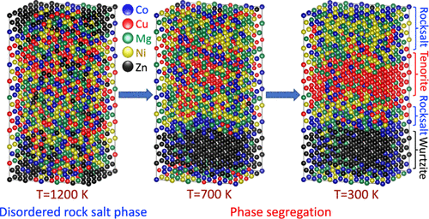
P56.00002: Predicting the phase stability of high entropy oxides
APS talk from our group:
Wednesday, March 17th
3:36 PM–3:48 PM
Krishna Pitike

Slide 3
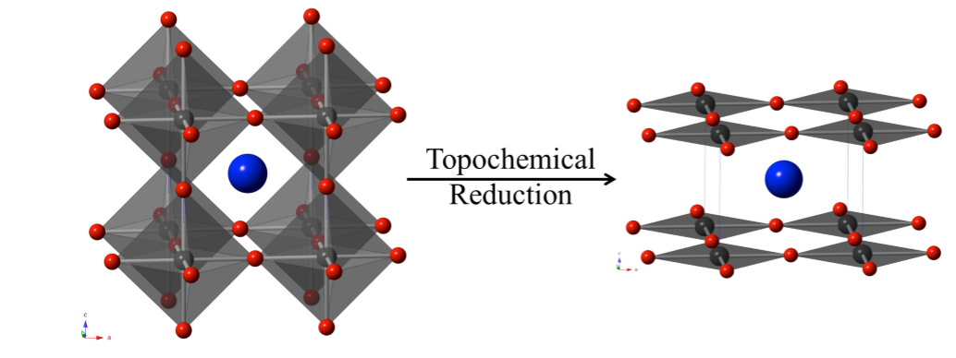
X37.00010 : Computational design of layered-oxide materials
APS talk from our group:
Friday, March 19th
10:12 AM–10:24 AM
Shree Ram Acharya

