Slide 1
US-Africa Initiative Workshop APS March Meeting - Sunday, March 14, 2021 Sponsored by the APS Innovation Fund
...continued from previous column
- Information on the group in which you work (names of other people directly related to your work, how many people total, types of work in the group, topical areas)
- What collaborations have been helpful so far, if any.
- What collaborations or resources would be beneficial in the next steps?
- Any links to more information or samples]
[Poster presenter’s name]
[Institution, position (for example masters student, PhD student, Lecturer, Professor, other), email]
[Title or description of work and ideas for collaboration]
[In the rest of the space on this slide, please provide:
- Description of your primary interests and research goals, work that you have accomplished so far....continued in next column

Slide 2
[More About Your Research and Possible Collaborations]
[If you want, add a second slide that explains more about your work and what you would like to do. It can be in the format you choose. You could include group photos.]
[If you want, include links to other information about your work or the work in your group.]
[If appropriate, include a reference to a talk (or talks) you or your group is giving at this 2021 APS March Meeting.]

Slide 3
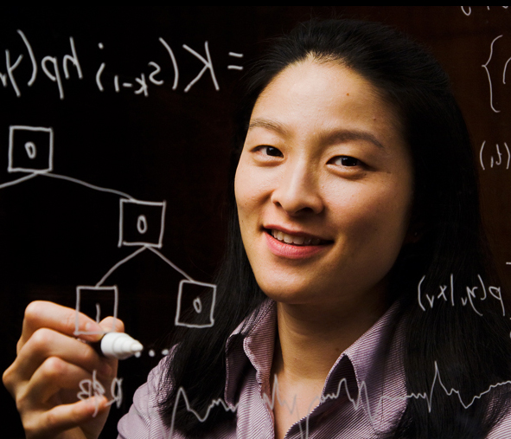
US-Africa Initiative Workshop APS March Meeting - Sunday, March 14, 2021 Sponsored by the APS Innovation Fund
The primary methods used in our group are density functional calculations, which are then fit to models in order to treat large systems. We have a collaboration with the group of Prof. I. M. Handy in the College of Engineering who makes batteries using non-equilibrium ion exchange methods.
My goal for future collaborations is to participate in projects in computational discovery of materials, so that I can learn how to use machine learning and other methods. This work will require access to powerful computers.
An example of my work is a poster I gave at the 2020 MultiScale Multi meeting at http://drive.google.com/documents/08836234876etc.
Amy M. C. Squared
2022 PhD candidate
Western Pacific College
mcsquared@wpc.edu
My ambition is to discover materials and systems for solar energy. I am a PhD student in the group of Prof. D. F. T. Smart, which consists of myself and 2 other students.
EXAMPLE SLIDE

